Slide 1

PERIODICITY
TRENDS IN THE PERIODIC TABLE (1)

Slide 2
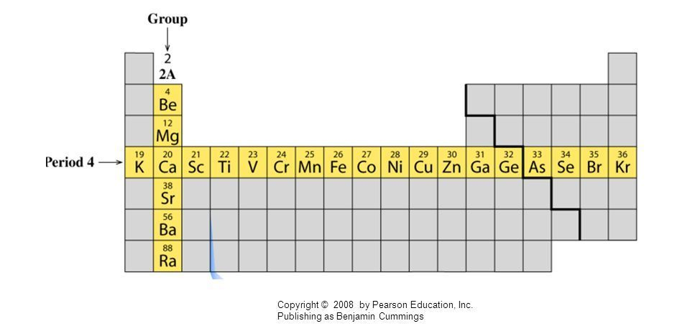
INQUIRY INTO THE TRENDS
Explore the trends and patterns that exist within the Periodic table. These trends can help us to predict an elements properties. The three trends we will be studying are:
Atomic radius
Ionisation energy
Electronegativity

Slide 3
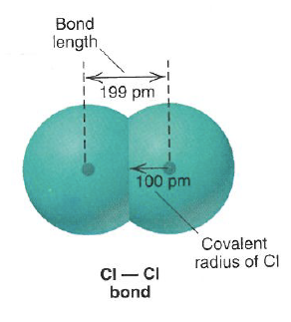
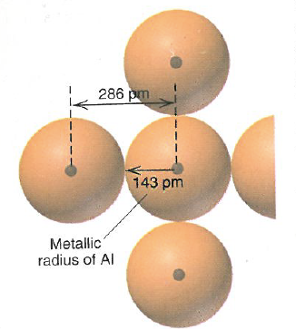
1. ATOMIC RADIUS
The covalent radius is one half the distance between identical covalently bonded atoms
Is the distance between the nucleus and the outer most valance electrons
Cannot be measured for an individual atom but we can measure the distance between two atoms in a bond. From this we can calculate the atomic radius.
The metallic radius is one half the distance between nuclei of adjacent atoms in a crystal of the element

Slide 4
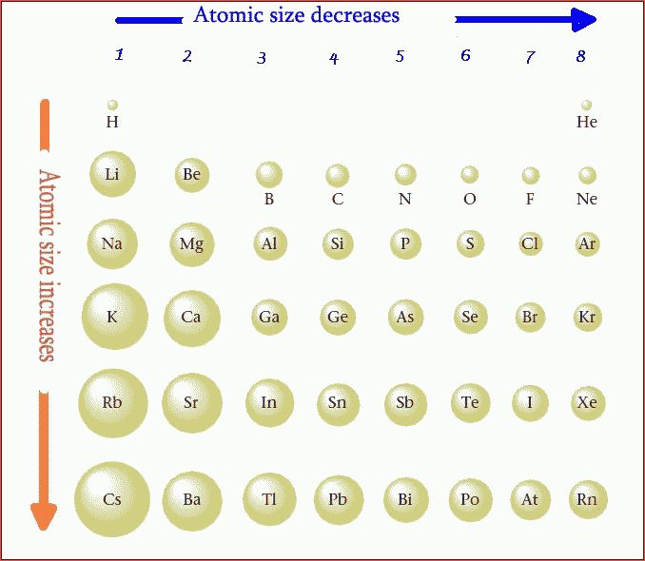
1. ATOMIC RADIUS
What is the trend:
Down a group?
Across a period?
Through the table as a whole?

Slide 5
1. ATOMIC RADIUS
Group Trend – As you go down a column, atomic radius increases
Period Trend – As you go across a period (L to R), atomic radius decreases
Whole table Trend – As go from bottom left to top right (diagonal), atomic radius decreases

Slide 6
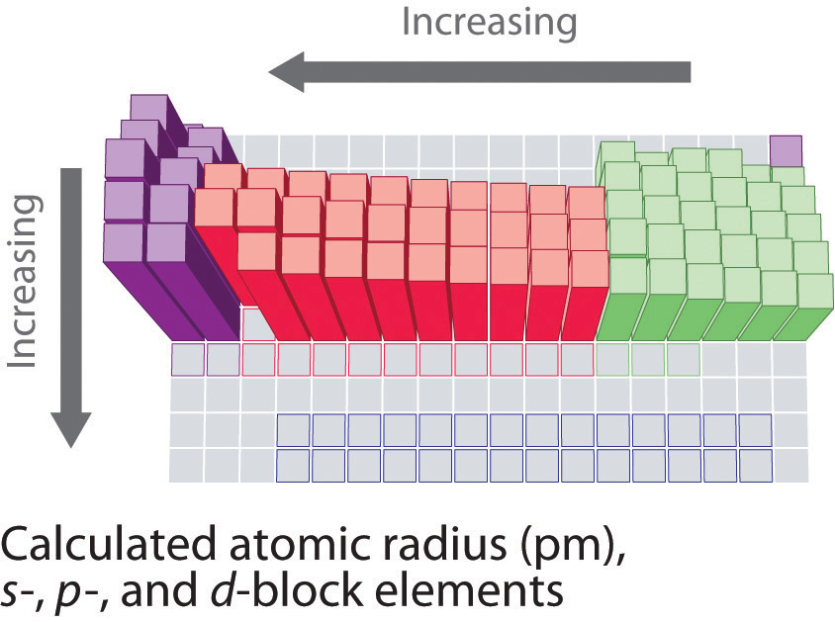
1. ATOMIC RADIUS

Slide 7
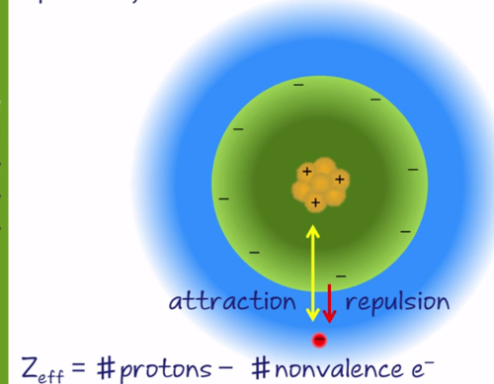
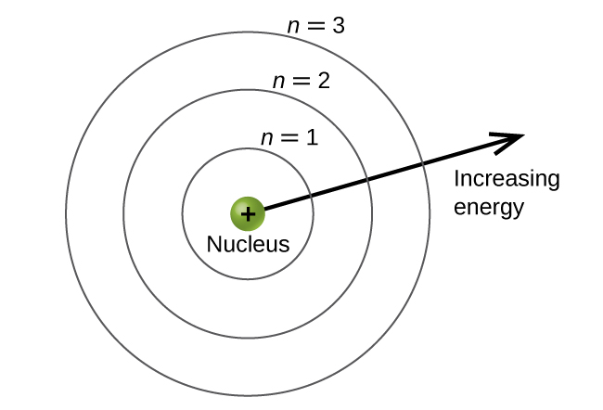
1. ATOMIC RADIUS
Explaining the trends – need to consider two factors to explain the trend:
Principal Quantum Number (n)
Effective nuclear charge (Z_{eff})

Slide 8
1. ATOMIC RADIUS
Principal Quantum Number (n)
This is the number of shells using the Bohr model of the atom.
The first shell is n=1, the next shell is n=2
So the quantum number tells us how many shells of electrons there are.
Each shell is a different distance from the nucleus.
The further away the electron shell is the attractive force of the positive nucleus to the electrons decreases.

Slide 9
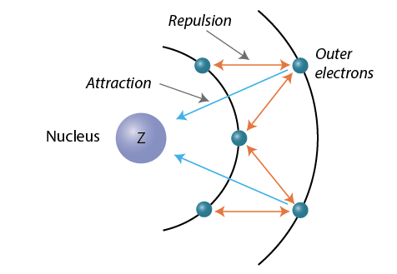
1. ATOMIC RADIUS
Effective nuclear charge (Z_{eff})
Recall – atomic radius is from nucleus and valence electrons. The electrons (negatively charged) are electrostatically attracted to the positive nucleus
The positive nucleus is shielded by the inner (core) electrons (makes it less attractive to the valence e-)
A larger Z_{eff} will pull the valence shell closer to the nucleus
Z_{eff} = Z – (# of core electrons)

Slide 10

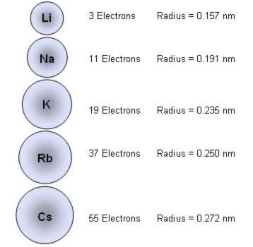
1. ATOMIC RADIUS
Moving down the group
n dominates:
Moving down a group there is one more electron shell added to the atom. The full inner shells shield the outer electrons keeping Z_{eff} the same for the group. As added shell is further away from the nucleus, the atomic radii gets larger.
Note: The effective nuclear charge remains constant despite the increase in nuclear charge as there is an extra full inner core shell to shield the nucleus.

Slide 11
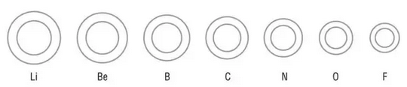
1. ATOMIC RADIUS
Moving across a period
Z_{eff} dominates:
As we move across a period, the electrons are added to the same outer shell. As the full inner shells shielding the nuclear charge remains the same, Z_{eff} rises across the period. This pulls the outer electron shell closer decreasing atomic radii.

Slide 12
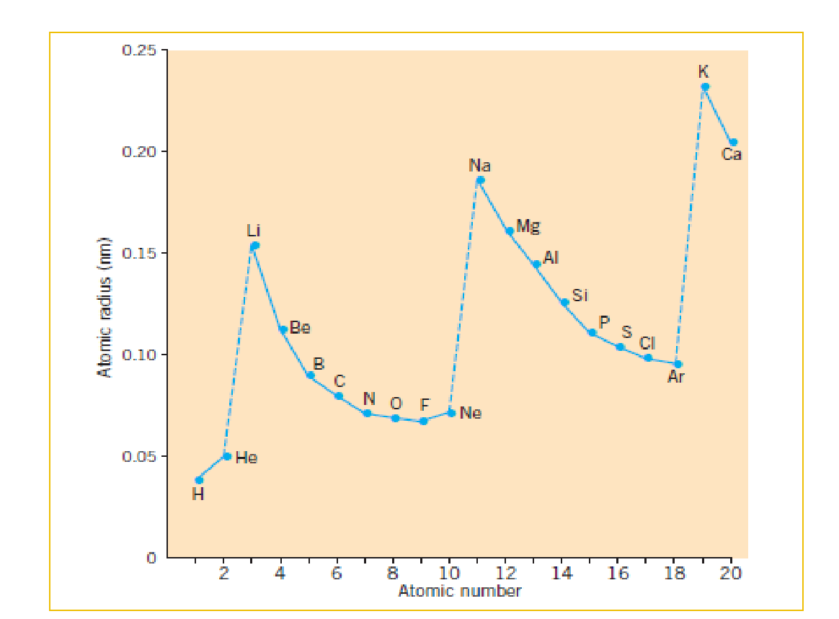
1. ATOMIC RADIUS
We can also represent this as a graph of Radius vs Atomic number
The graph clearly shows TWO trends
Trend 1: Atomic radius increases down a group as seen here with Li, Na and K
Trend 2: Atomic radius decrease left to right across a period as seen here with Li to Ne.

